Slide 1
BASIC CRYSTALLOGRAPHY

Slide 2
Matter
Solid
Liquid
Gas
Liquid crystal
Crystalline
Amorphous
Quasicrystals
Nobel Prize 2011

Slide 3
The Crystalline State
Lattice = How/ Where to repeat
Motif = What to repeat
Crystal = Lattice + Motif
Seven Crystal System
Fourteen Bravais Lattice
Miller Indices

Slide 4
Lattice?
Translationally periodic arrangement of points in space is called a lattice.
Depending upon the periodic arrangement of points in 1D/2D/3D, we can have 1D/ 2D/ 2D Lattices respectively.
It is not a physical thing, it is simply a geometrical concept having geometrical properties.
It is infinite in general, and is produced by a point trough Lattice translation in space. Lattice translation vector is defined as any vector from one lattice point to another lattice point.

Slide 5
7 Crystal Systems and 14 Bravais Lattices
 | Crystal System | Bravais Lattices
1. | Cubic | P | I | F
2. | Tetragonal | P | I
3. | Orthorhombic | P | I | F | C
4. | Hexagonal | P
5. | Trigonal | P
6. | Monoclinic | P |  |  | C
7. | Triclinic | P
P: Simple; I: body-centred;
F: Face-centred; C: End-centred

Slide 6

The three cubic Bravais lattices
Crystal system Bravais lattices
1. Cubic P I F
Simple cubic Primitive cubic Cubic P
Body-centred cubic Face-centred cubic Cubic I Cubic F

Slide 7
Orthorhombic C
End-centred orthorhombic Base-centred orthorhombic

Slide 8
Cubic Crystals?
a=b=c; α=β=γ=90°

Slide 9
7 crystal Systems
Unit Cell Shape
1. a=b=c, α=β=γ=90°
2. a=b≠c, α=β=γ=90°
3. a≠b≠c, α=β=γ=90°
4. a=b≠c, α=β= 90°, γ=120°
5. a=b=c, α=β=γ≠90°
6. a≠b≠c, α=β=90°≠γ
7. a≠b≠c, α≠β≠γ
Crystal System Cubic Tetragonal Orthorhombic Hexagonal
Rhombohedral OR Trigonal
Monoclinic Triclinic

Slide 10
Why half the boxes are empty?
 | Crystal System | Bravais Lattices
1. | Cubic | P | I | F | ?
2. | Tetragonal | P | I
3. | Orthorhombic | P | I | F | C
4. | Hexagonal | P
5. | Trigonal | P
6. | Monoclinic | P |  |  | C
7. | Triclinic | P
E.g. Why cubic C
is absent?

Slide 11



End-centred cubic not in the Bravais list ?
a
a
2
2
End-centred cubic = Simple Tetragonal

Slide 12
14 Bravais lattices divided into seven
crystal systems
Crystal system
Cubic P
Tetragonal P
Orthorhombic P
Hexagonal P
Trigonal P
Monoclinic P
Triclinic P
Bravais lattices
I I I
F
C
F
C
C

Slide 13







Now apply the same procedure to the FCC lattice
Cubic F = Tetragonal I ?!!!

Slide 14
14 Bravais lattices divided into seven crystal systems
Crystal system Bravais lattices
Cubic P
Tetragonal P
Orthorhombic P
Hexagonal P
Trigonal P
Monoclinic P
Triclinic P
I I I
F
C
F
C
C

Slide 15
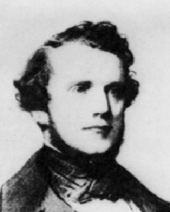
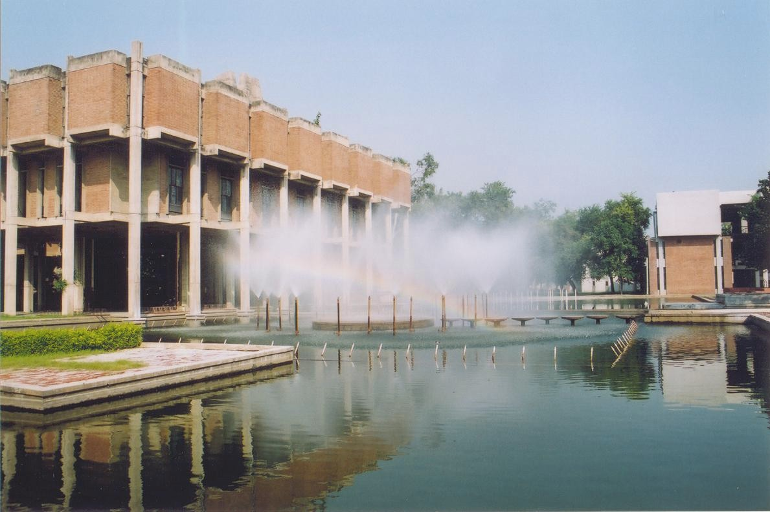
History:
KANPUR
ML Frankenheim
1801-1869
Auguste Bravais
1811-1863
1850: 14 lattices
1ST FEB. 2016:
13 lattices !!!
1835:
X15 lattices
14 lattices
1856:
Couldn’t find his photo on the net

Slide 16
UNIT CELLS OF A LATTICE
Non- primitive cell
A unit cell of a lattice is NOT unique.
Primitive cell
Unit cell shape CANNOT be the basis for classification of Lattices
Primitive cell

Slide 17
Why can’t the Face- Centred Cubic lattice (Cubic F) be considered as a Body-Centred Tetragonal lattice (Tetragonal I) ?

Slide 18
What is the basis for classification of lattices into
7 crystal systems and
14 Bravais lattices?

Slide 19
Lattices are classified on the basis of their symmetry

Slide 20
Symmetry?
If an object is brought into self- coincidence after some operation it said to possess symmetry with respect to that operation.

Slide 21
Translational symmetry
Lattices also have translational symmetry
In fact this is the defining symmetry of a lattice

Slide 22
Rotation Axis
If an object come into self-coincidence through smallest non-zero rotation angle of θ then it is said to have an n- fold rotation axis where
360⁰
n =
θ
θ=180° n=2
2-fold rotation axis
θ=90° n=4
4-fold rotation axis

Slide 23


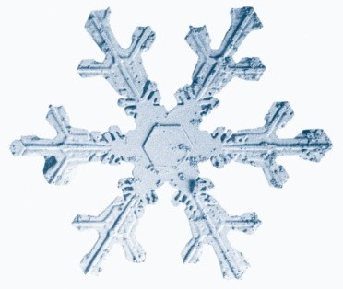
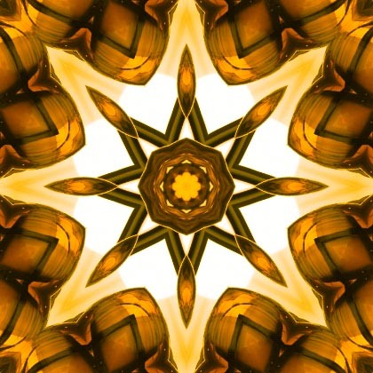

Examples of Rotational Symmetry
Z
Angles:
180° 120° 90°
Fold:
2 3 4
72°
5
60°
6
45°
8
Graphic symbols

Slide 24
Crsytallographic Restriction
5-fold symmetry or Pentagonal symmetry is not possible for Periodic Tilings
Symmetries higher than 6-fold also not possible
Only possible rotational symmetries for lattices
2 3 4 5 6
7 8 9…

Slide 25
Symmetry of lattices
Lattices have
Translational symmetry Rotational symmetry Reflection symmetry

Slide 26
Point Group and Space Group
The group of all symmetry elements of a crystal except translations (e.g. rotation, reflection etc.) is called its POINT
GROUP.
The complete group of all symmetry elements including translations of a crystal is called its SPACE GROUP

Slide 27
Classification of Lattices
Crystal systems and Bravais Lattices
Based on the point group symmetry
alone (i.e. excluding translational symmetry
7 types of lattices
  7 crystal systems
Based on the space group symmetry, i.e., rotational, reflection and translational symmetry
  14 types of lattices
⇒ 14 Bravais lattices

Slide 28


7 crystal Systems
Defining symmetry
Crystal system
Conventional unit cell
a=b=c, α=β=γ=90°
a=b≠c, α=β=γ=90°
4
only 1
3
or
or
Cubic
Tetragonal
or m
₁ or
only 1 or
only 1 or m
None or i
_{Orthorhombic} a≠b≠c, α=β=γ=90°
Hexagonal
a=b≠c, α=β= 90°, γ=120°
_{Rhombohedral} a=b=c, α=β=γ≠90°
Monoclinic
Triclinic
a≠b≠c, α=β=90°≠γ
a≠b≠c, α≠β≠γ

Slide 29












Tetragonal symmetry
Cubic symmetry
Cubic C = Tetragonal P
Cubic F ≠ Tetragonal I

Slide 30
a=b≠c, α=β=γ=90°
A tetragonal unit cell with two opposite rectangular faces centred.
Bravais Lattice?

Slide 31
Crystal ?
A 3D translationally periodic arrangement of atoms in space is called a crystal.

Slide 32
Crystal vs. Lattice
Crystal
A 3D
translationally periodic arrangement of atoms
Lattice
A 3D
translationally periodic arrangement of points

Slide 33
Relation between crystal and lattice?
Crystal = Lattice + Motif
Motif or basis: an atom or a group of atoms associated with each lattice point

Slide 34
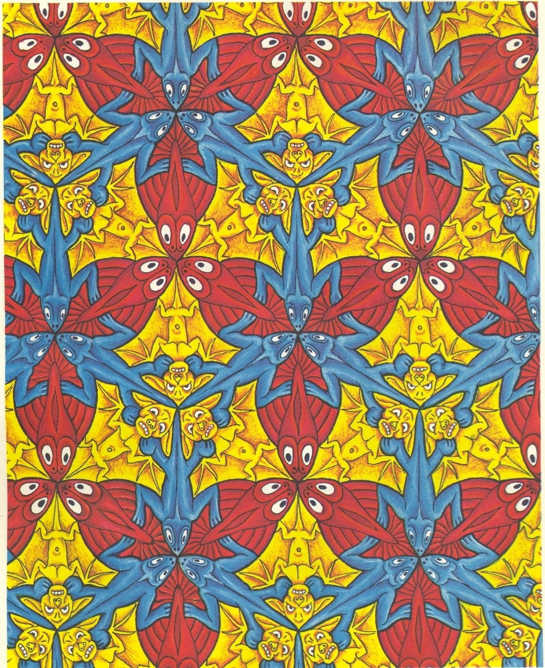
by M.C.Esher
Air, Water and Earth

Slide 35
Air, Water and Earth
by M.C.Esher
Every periodic pattern (and hence a crystal) has a unique lattice associated with it

Slide 36
1965
Symmetry Aspects of M. C. Escher's Periodic Drawings
Macgillavry, Caroline H. (Professor of
Chemical Crystallography, Univ. of Amsterdam)
International Union of Crystallography

Slide 37
Escher:
Art or Science?
Prof. Sanil’s Class, Every semester since 2008 Bangalore, May 26, 2009

Slide 38
The six lattice parameters
a, b, c, α, β, γ
The unit cell of the lattice
lattice
+ Motif
crystal

Slide 39
Hexagonal Close Packed (HCP) Lattice?
 | Crystal System | Bravais Lattices
1. | Cubic | P | I | F
2. | Tetragonal | P | I
3. | Orthorhombic | P | I | F | C
4. | Hexagonal | P
5. | Trigonal | P
6. | Monoclinic | P |  |  | C
7. | Triclinic | P

Slide 40
Only hexagonal lattice is Simple hexagonal
HCP Lattice
HCP crystal: ..ABAB.. Stacking of closed-packed layers
A and B not translationally equivalent HCP crystal = Hexagonal P lattice
+ 2 atom motif (1A & 1B)

Slide 41
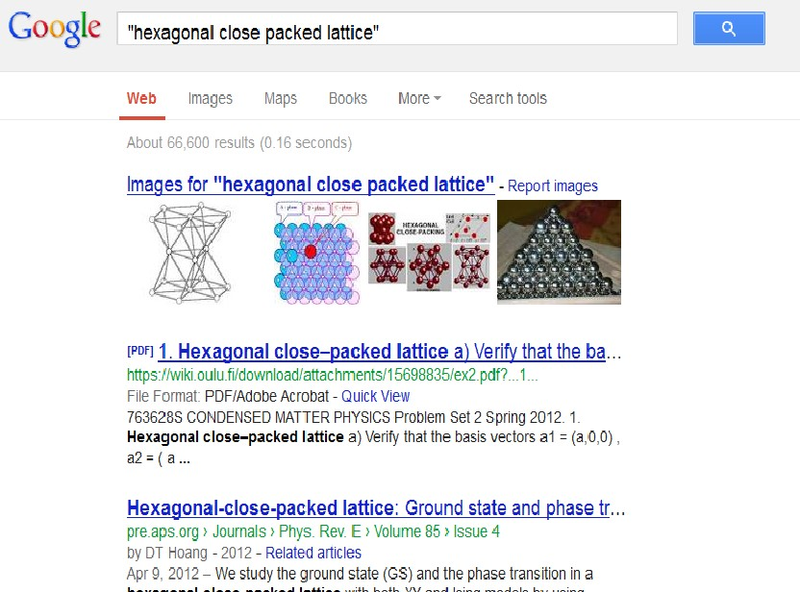
On 21.03.2013

Slide 42
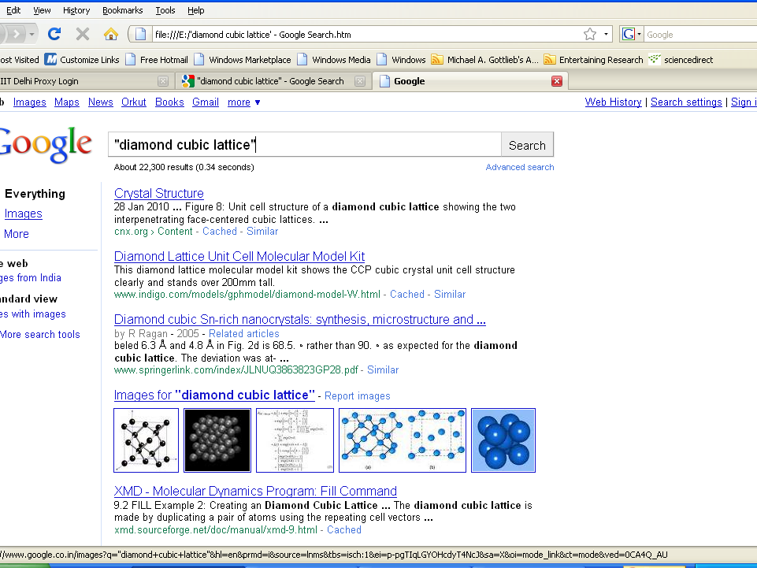
There is no diamond cubic lattice.
4343/87

Slide 43
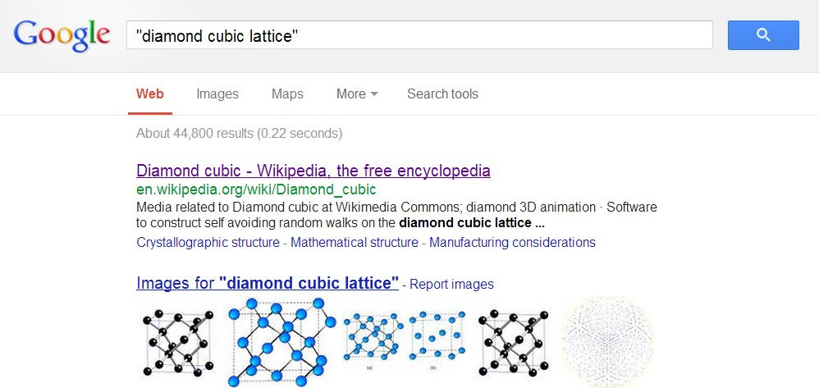

Slide 44
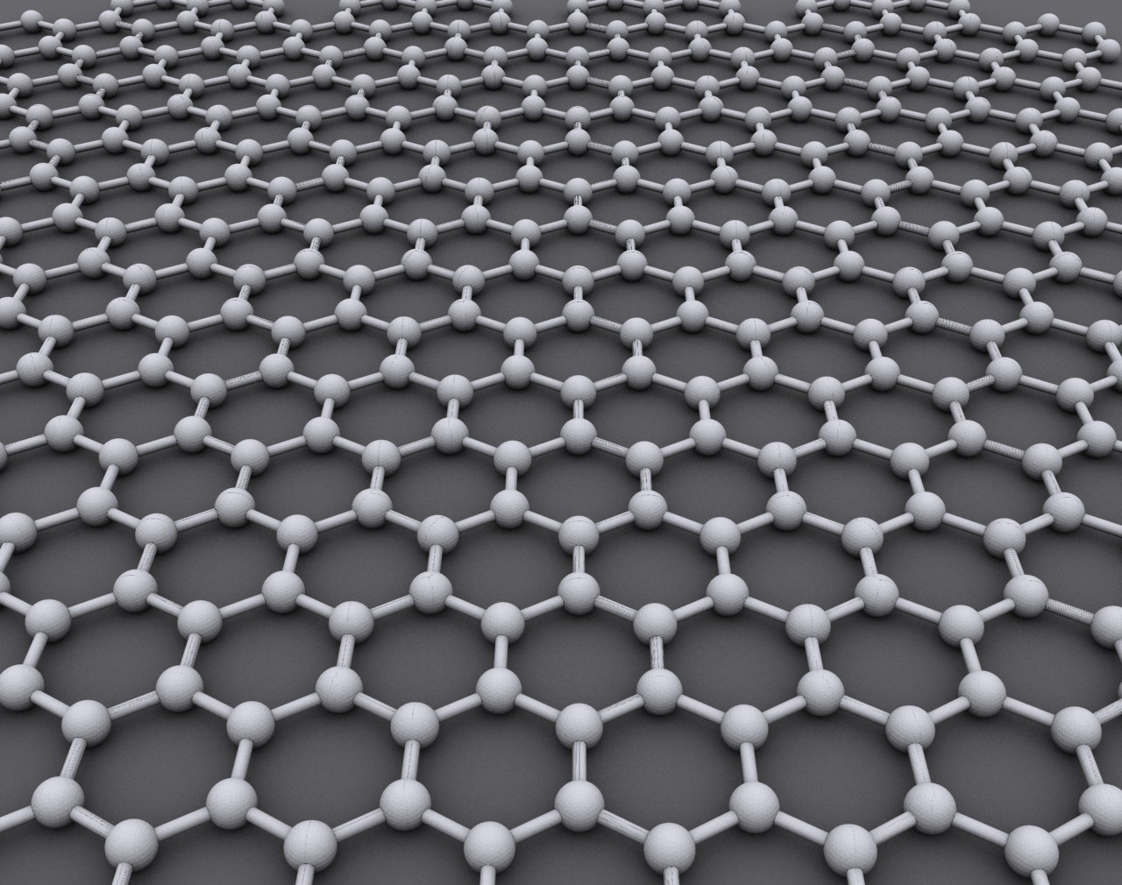
Nobel Prize in Physics 2010
Andrew Giem and Konstantin Novoselov
45/87

Slide 45
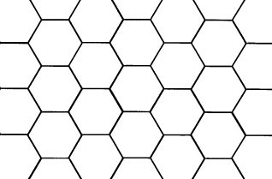
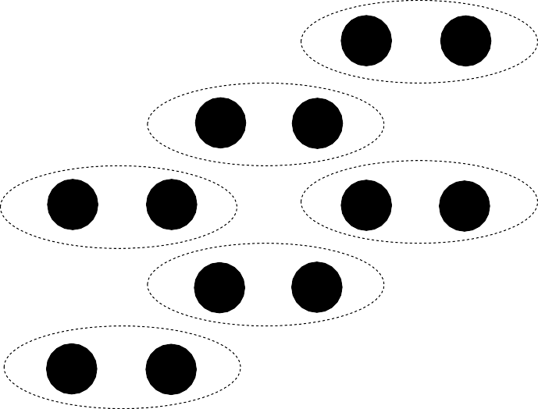
Crystal structure of Graphene
Graphene crystal = hexagonal Lattice + 2 atom motif

Slide 46









Monatomic Body-Centred Cubic (BCC) crystal
CsCl crystal (B2)
Cl
Cs
Corner and body-centres have the same neighbourhood
Corner and body-centred atoms do not have the same neighbourhood
Lattice: bcc
Lattice: simple cubic
BCC
Feynman!
Motif: 1 atom 000
Motif: two atoms
Cl 000; Cs ½ ½ ½

Slide 47


Richard P. Feynman
Nobel Prize in Physics, 1965

Slide 48
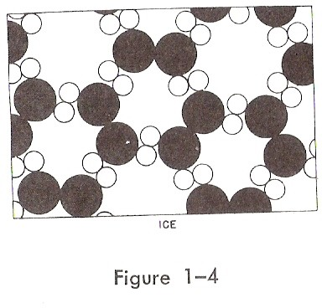
Feynman’ s Lectures on Physics Vol 1
Chap 1
Hexagonal symmetry
360 _{o}
θ = = 60
6
Fig. 1-4
“Fig. 1-4 is an invented arrangement for ice, and although it contains many of the correct features of the ice, it is not the true arrangement. One of the correct features is that there is a part of the symmetry that is hexagonal. You can see that if we turn the picture around an axis by 120°, the picture returns to itself.”

Slide 49
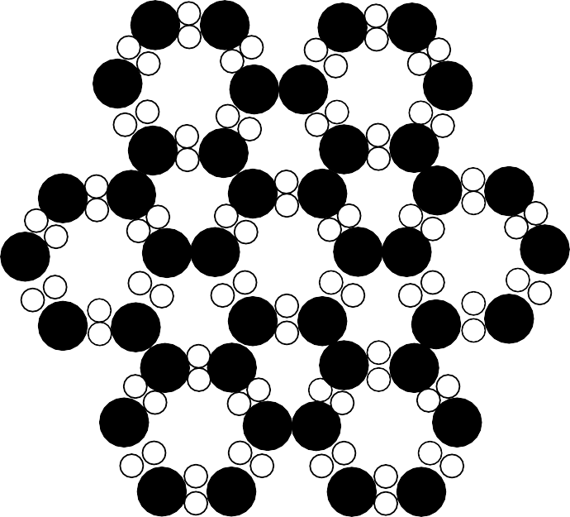



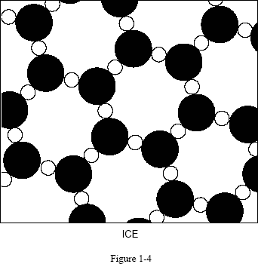
Correction: Shift the box
One suggested correction:
But gives H:O = 1.5 : 1

Slide 50
Summary
Lattice: translationally periodic set of points.
Crystal: translationally periodic set of atoms.
Motif or basis: an atom or group of atoms associated with each lattice point
Crystal=Lattice+Motif HCP is a crystal structure and not a lattice.
7 crystal system and 14 Bravais: symmetry (not unit cell)
7 crystal system: 7 different point groups of lattices
14 Bravais lattices: 14 different space groups of lattices

Slide 51
We hope this book will help in clearing up the confusion that many solid state scientists encounter when starting to study solid state symmetry. How many well-established scientists still believe that all cubic crystals must have axes of fourfold symmetry, for example? In a similar vein how many of them would define a crystal system according to the lengths of the unit cell axes and their interaxial angles? How many know which character tables to use for a crystal that has a glide plane or a screw axis? If we can clarify a few of these kinds of problems, and nothing else, we shall feel that the writing of this have been worthwhile.
Burns and Glazer in the preface of their book
“Space Groups for Solid state Scientists”

Slide 52
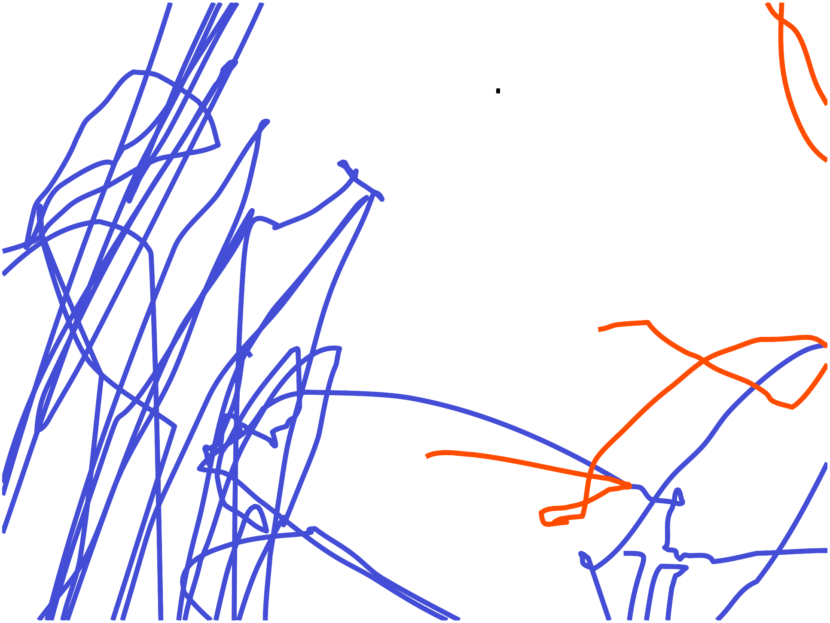
QUESTIONS?

Slide 53
Miller Indices
54/
100

Slide 54
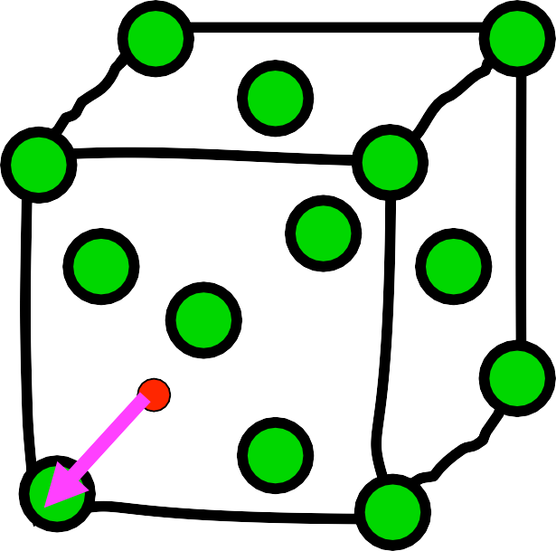
Miller Indices of Directions
Miller Indices 2
Choose a point on the direction
as the origin.
Choose a coordinate system with axes parallel to the unit cell edges.
z
c
y 3. Find the coordinates of another point on the direction in terms of a, b and c
1, 0, 0
b
a
1a+0b+0c
x
Reduce the coordinates to smallest integers. 1, 0, 0
Put in square brackets [100]
55⁵/⁵7/7
55

Slide 55
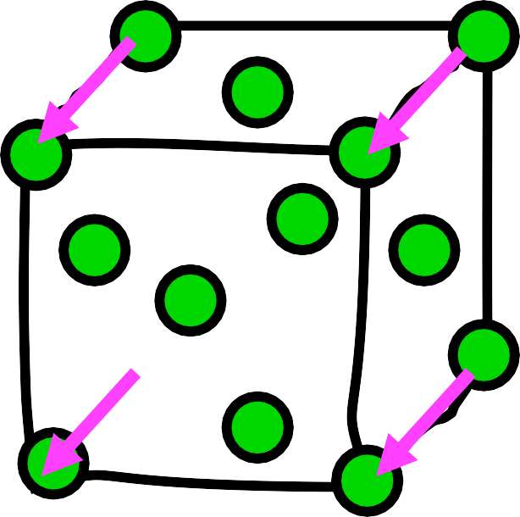
Miller Indices 3
z
Miller indices of a direction: only the orientation
not its position or sense
y
[100]
x
All parallel directions have the same Miller indices
56⁵/⁶7/7
56

Slide 56
Miller Indices of Directions (contd.)
Direction OA
OA=1/2 a + 1/2 b + 1 c
1/2, 1/2, 1
[1 1 2]
Direction PQ
PQ = -1 a -1 b + 1 c
z
Q
z
A
y
y
O
-1, -1, 1
__
[ 1 1 1 ]
x
P
x
-ve steps are shown as bar over the number
57⁵/⁷7/7
57

Slide 57
Miller Indices 4
Miller indices of a family of symmetry related directions
uvw
= [uvw] and all other directions related to [uvw] by the symmetry of the crystal
[001]
Tetragonal
Cubic
[010]
[010]
[100]
[100]
100
= [100], [010],
[001]
100
= [100], [010]
tetragonal
cubic
58⁵/⁸7/7
58

Slide 58
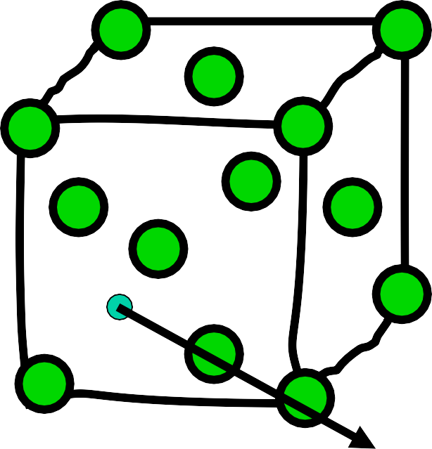
Miller indices of slip directions in CCP
Miller Indices 5
Slip directions = close-packed directions = face diagonals
Six slip directions:
[110]
[101]
[011]
[ 101]
[110]
[101]
[101]
[101]
[101]
z
[011]
All six slip directions in ccp:
110
y
[110]
[110]
x
59⁵/⁹7/7
59

Slide 59
Miller Indices for planes
z
Select a crystallographic coordinate system with origin not on the plane
Find intercepts along axes
1 1 1
Take reciprocal 1 1 1
Convert to smallest integers in the same ratio
1 1 1
Enclose in parenthesis
(111)
y
O
x
60⁶/⁰7/7
60

Slide 60
Miller Indices for planes (contd.)
OCBE
O*
intercepts 1 ∞ ∞ ¹ ⁻¹
∞
reciprocals 1 0 0 1 -1 0
Miller _
Indices (1 0 0) (1 1 0)
Plane origin
ABCD O
z
z
E
A _{B}
O
O*
y
Zero represents that the plane is parallel to the corresponding axis
Bar represents a negative intercept
D
C
x
x
61⁶/¹7/7
61

Slide 61
Miller indices of a plane specifies only its orientation in space not its position
z
All parallel planes have the same Miller Indices
E
_ _ _
(h k l ) ≡ (h k l )
A _{B}
O
_
(100) ≡ (100)
y
D
C
x
(100)
62⁶/²7/7
62

Slide 62
_{{hkl }} = (hkl ) and all other planes related to
Miller indices of a family of symmetry related planes
(hkl ) by the symmetry of the crystal
All the faces of the cube are equivalent to each other by symmetry
Front & back faces: (100) Left and right faces: (010) Top and bottom faces: (001)
{100} = (100), (010), (001)
63⁶/³7/7
63

Slide 63
Miller indices of a family of symmetry related planes
z
Cubic
z
Tetragonal
y
y
x
x
{100}_{cubic} = (100), (010), (001)
{100}_{tetragonal} = (100), (010)
(001)
64⁶/⁴7/7
64

Slide 64
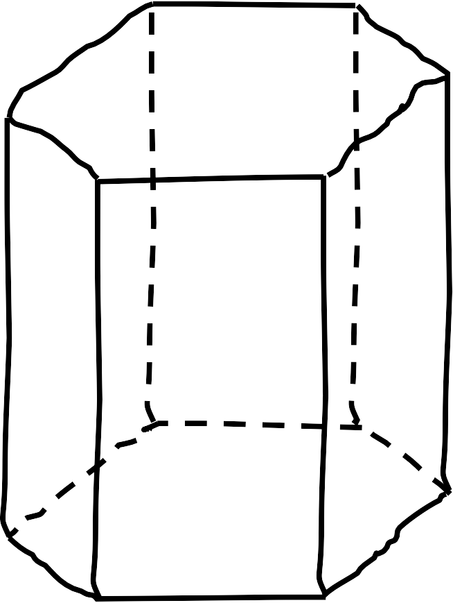
Symmetry related directions in the hexagonal crystal system
z
100
= [100], [010], [110]
hexagonal
Not permutations
₁₀₀ = [100], [010], [001]
cubic
[110]
Permutations
y
[010]
x
[100]
65⁶/⁵7/7
65

Slide 65
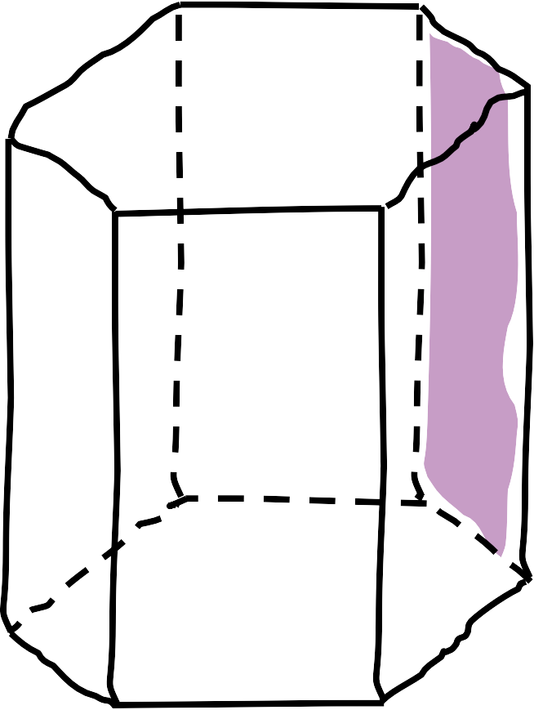
Symmetry related planes in the hexagonal crystal system
z
(110)
{100}_{hexagonal} = (100), (010), (110)
Not permutations
{100}_{cubic} = (100), (010), (001)
y
Permutations
(010)
(100)
x
66⁶/⁶7/7
66

Slide 66
Problem:
In hexagonal system symmetry related planes and directions do NOT have Miller indices which are permutations
Solution:
Use the four-index Miller- Bravais Indices instead
67⁶/⁷7/7
67

Slide 67
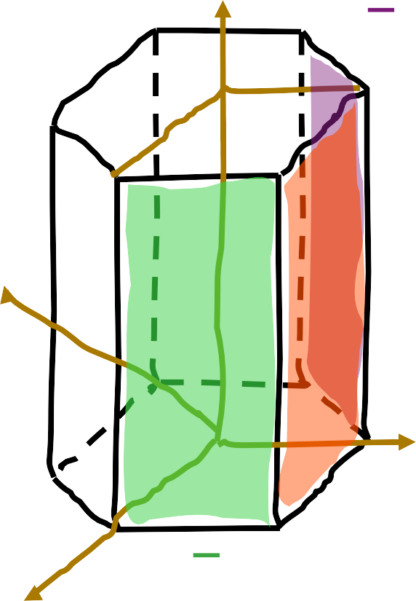
Miller-Bravais Indices of Planes
x₃
Introduce a fourth axis in
the basal plane
z
(1100)
x₁
Prismatic planes:
x₂
x₃
{1100} = (1010) (0110)
(1100)
x₂
(0110)
(hkl)=>(hkil) with i=-(h+k)
(1010)
x₁
68⁶/⁸7/7
68

Slide 68
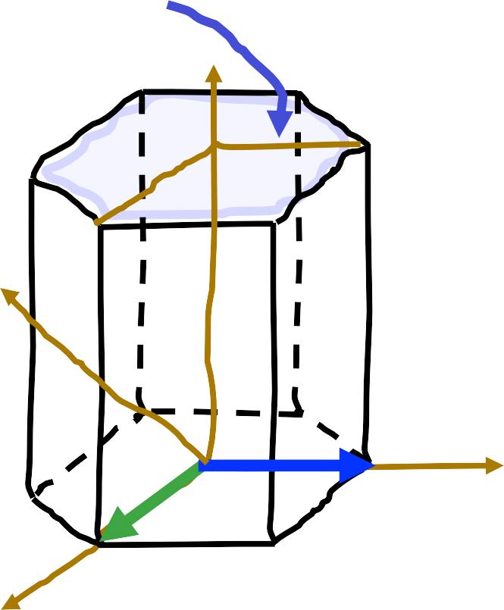
Miller-Bravais Indices of Directions in hexagonal crystals _{[uvw]=>[UVTW]}
Vectorially
a₁ + a₂ + a₃ = 0
Basal plane
=slip plane
=(0001)
Require that:
U + V + T = 0
Ua₁ +Va₂ +Ta₃ +Wc
x₃
= ua₁ + va +wc
2
a₂
x₂
a₂
a₁
1
1
x₁
U = ₃ (2u − v);
V = ₃ (2v − u);
T = −(u + v);
W = w _{69/}
69/77
69

Slide 69
Miller-Bravais indices of slip directions in hcp crystal:
U = ¹ (2u − v); V = ¹ (2v − u); T = −(u + v); W = w
3 3
x₃
[100] ⇒ [ ]≡[21 10]
2 ₋ 1
3 3 3
1
x₁:
− 0
a₃
x₂
[010] ⇒ [− ]≡[1210]
a₂
1 2
3 3 3
1
x :
− 0
2
a₁
[1 10] ⇒ [ ]≡[1 1 20]
x₃:
₋ 1 ₋ 1 2
3 3 3
0
a₁
-a₂
Slip directions in hcp
21 10
-a₃
x₁
[21 10]
70⁷/⁰7/7
70

Slide 70
Weiss zone law
Some IMPORTANT Results
Condition for a direction [uvw] to be parallel to a plane or lie in the plane (hkl):
h u + k v + l w = 0
h U + k V + i T +l W = 0
True for ALL crystal systems
71/87
71/77

Slide 71
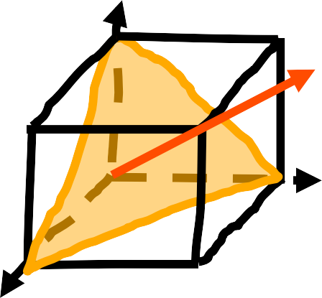
CUBIC CRYSTALS
[111]
[hkl] ⊥ (hkl)
C
(111)
Angle between two directions [h₁k₁l₁] and [h₂k₂l₂]:
h₁h₂ + k₁k₂ + l₁l₂
cosθ =
h² + k ² + l ² h² + k ² + l ²
1 1 1 2 2 2
72⁷/²7/7
72

Slide 72
^{d}hkl
Interplanar spacing between ‘successive’ (hkl) planes passing through the corners of the unit cell
cubic
a
^{d}hkl
=
h² +k ² +l
2
z
E
B
O
O
d₁₀₀ = a
a
d =
110
2
(100)
x
x
73⁷/³7/7
73

Slide 73
X-Ray Diffraction Convention
Normal convention:
Miller indices (hkl) cannot have any common factor.
X-Ray diffraction Convention:
(hkl) is idices of a Bragg reflection (diffraction) peak. It may have a common factor.
(nh,nk,nl) represents nth order reflection from (hkl)
(222) is the second order reflection from the (111)
74⁷/⁴7/7
74

Slide 74
Vectors vs Directions:
Miller Indices of a direction
[110] is a direction along the face diagonal of a unit cell. It is not a vector of fixed length
Exception:
The Burger’s vector
b = ¹ 〈111〉
A vector equal to half body diagonal
BCC
2
1
A vector equal to half face diagonal
FCC
b = ₂ 〈110〉
75⁷/⁵7/7
75

Slide 75
Summary of Notation convention for Indices
[uvw]
Miller indices of a direction (i.e. a set of parallel directions)
Miller indices of a family of symmetry related directions
<uvw>
(hkl)
Miller Indices of a plane (i.e. a set of parallel planes)
Miller indices of a family of symmetry related planes
{hkl}
[uvtw]
(hkil)
Miller-Bravais indices of a direction, plane in a hexagonal system
76/
76/77
76

Slide 76
Thank you
77/77

Slide 77
Appendices
Wigner seitz unit cell (Voronoi cell)
Brilluion zone
Proof of crystallographic restriction
Symmetry error in Feynman’s lecture
Quasicrystals
Anisotropy of crystals: Neumann Principle
Elastic anisotropy of crystals
78/
100

Slide 78
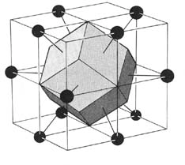
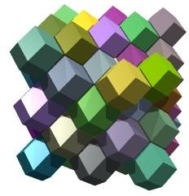
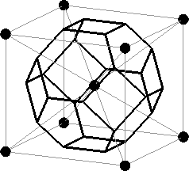
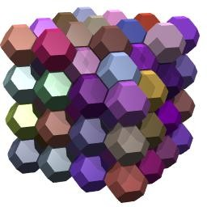
Wigner-Seitz Unit Cells (Voronoi Cells)
FCC
Rhombic Dodcahedron
BCC
Tetrakaidecahedron
79/
79

Slide 79
Brillouin Zones are nothing but Wigner- Seitz cell of the reciprocal lattice
Real lattice Reciprocal Lattice First Brillouin Zone
FCC
BCC
Rhombic Dodcahedron
BCC
FCC
Tetrakaidecahedron
80/
87

Slide 80
Proof of The Crystallographic Restriction
^{⎛⎛ t}11 ^{t}12 ^{t}13 ⎞⎞
⎜⎜ 21
A rotation can be represented by a matrix T = ⎜⎜t
⎟⎟
t t
22 23 ⎟⎟
⎜⎜ t₃₁ t t ⎟⎟
⎝⎝ 32 33 ⎠⎠
Trace[T ] = t₁₁ + t₂₂ + t₃₃ = 2cosθ +1
If T is a rotational symmetry of a lattice then all its elements must be integers (wrt primitive basis vectors)
∴2 cosθ +1 = N
⇒ −1 ≤ N ≤ 3
N | -1 | 0 | 1 | 2 | 3
θ | 180° | 120° | 90° | 60° | 0°
n-fold | 2 | 3 | 4 | 6 | 1
81/87

Slide 81
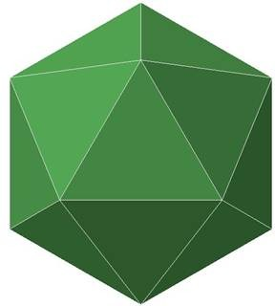
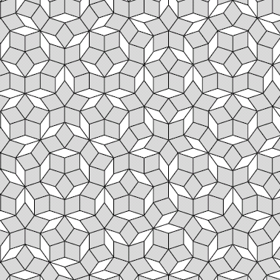
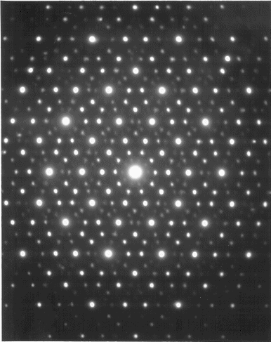
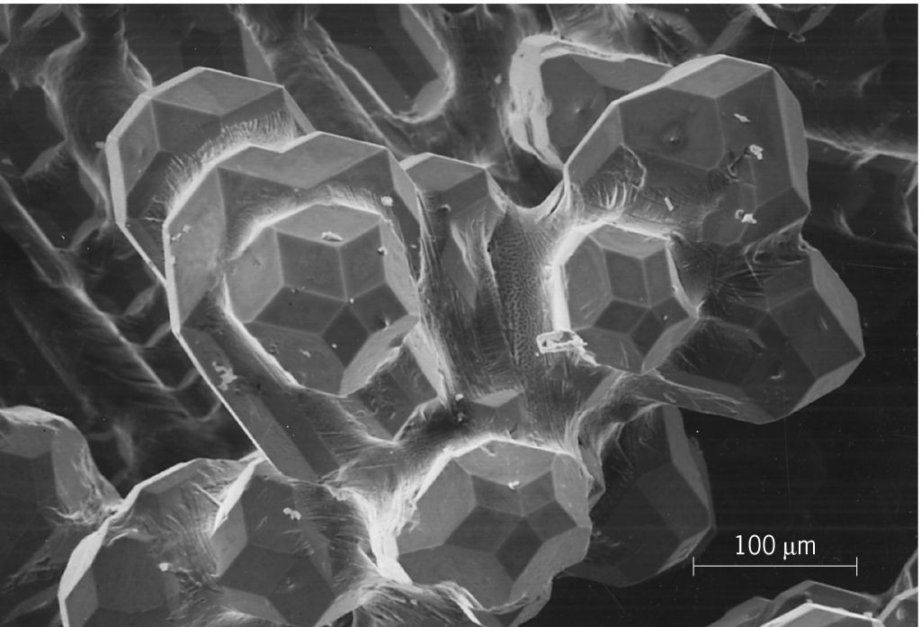
QUASICRYSTALS (1984)
Icosahedral symmetry (5-fold symmetry)
Lack strict translational periodicity -> Quasiperiodic
Icosahedron
Penrose Tiling
Diffraction Pattern
External Morphology
82/87

Slide 82
Neumann’s Principle
Symmetry elements of a physical property of a crystal must include all the symmetry elements of its point group (i.e., all its rotational axes and mirror planes).
Electrical resistance of a cubic crystal is isotropic (spherical symmetry)
All properties that can be represented by tensors of rank up to 2 are isotropic for cubic crystals
83/87

Slide 83
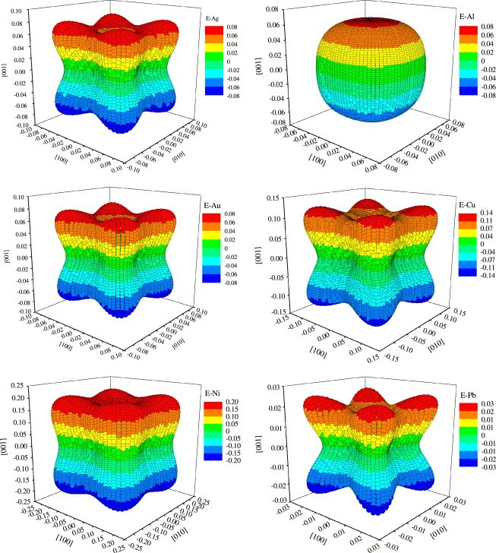
Elasic modulus (4th. Rank Tensor) is not isotropic
Al
Representation surfaces of Young’s modulus of fcc metals
Ag
Cu
Au
Jian-Min Zhanga,Yan Zhanga, Ke-Wei Xub and Vincent Ji
J Phys. Chem. Solids,
68 (2007) 503-510
84/87
Pb
Ni

Slide 84




Close packing of equal hard spheres
3-D packing
First layer A
A
A
A
A
Second layer B
Third layer A or C
C
C
C
B
B
B
A
A
A
A
C
C
C
B
B
B
A
A
A
A
C
C
C
B
B
B
A
A
A
A
Close packed crystals:
…ABABAB… Hexagonal close packed (HCP)
…ABCABC… Cubic close packed (CCP)
8585/87

Slide 85

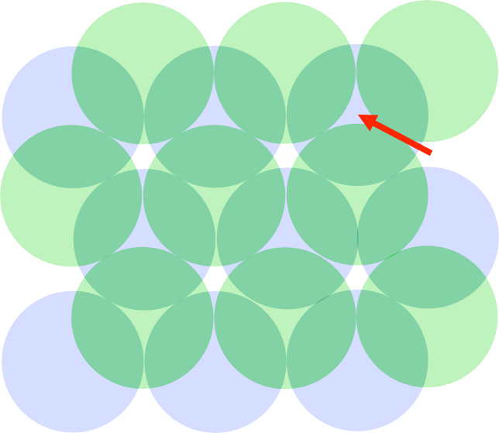

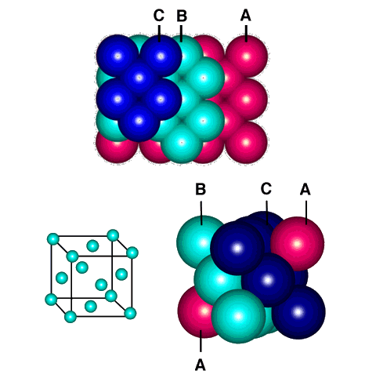

Geometrical properties of ABCABC stacking
C
A
A
A
B
A
A
C
C
C
B
B
B
√3 a
C
A
A
A
A
B
C
C
C
A
B
B
B
A
A
A
A
C
C
C
B
B
B
A
A
A
A
All atoms are equivalent and their centres form a lattice
Motif: single atom 000
ABCABC stacking
= CCP crystal
= FCC lattice + single atom motif 000
8686/87

Slide 86
Orientation Relationships
In solid state phase-transformation, the new crystalline phase has a particular orientation relationship with the parent phase.
When proeutectioid ferrite forms from austenite in steels the following orientation relationship, known as Kurdjumov-Sachs relationship is observed:
{110}_{α} || {111}_{γ}
< 111 >_{α} ||< 110 >_{γ}
87/
87

Slide 87
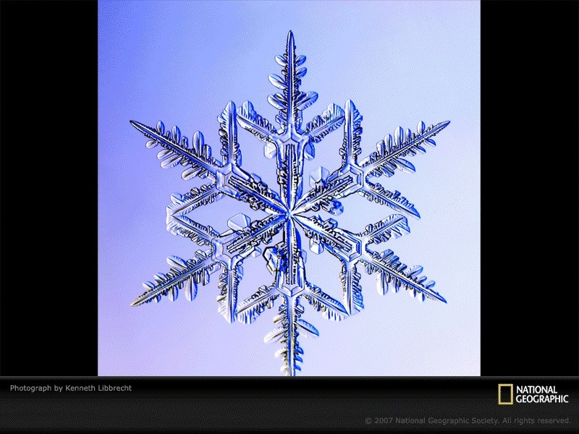
Dendrite Growth Directions
FCC
< 100 >
BCC
< 100 >
HCP
< 1010 >
88/
88

Slide 88
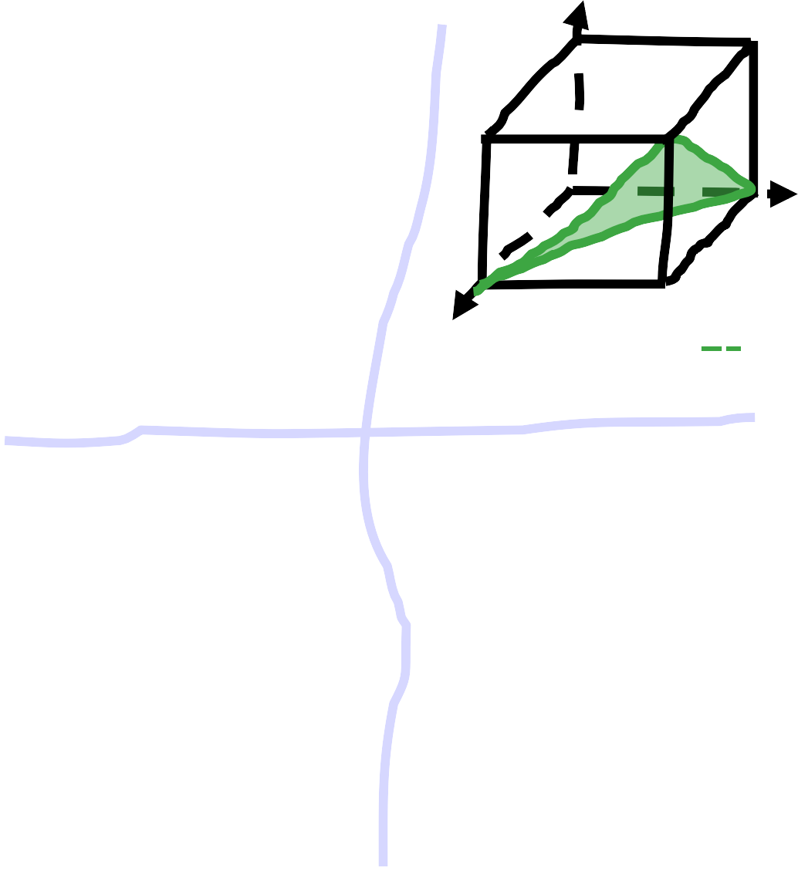
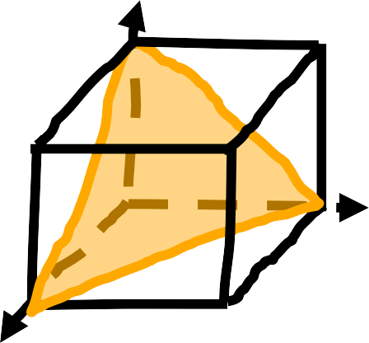
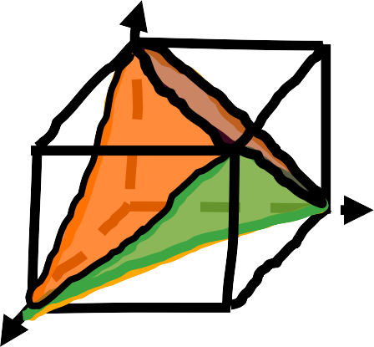
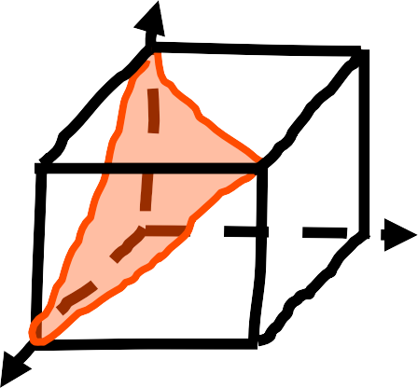
Slip planes in a ccp crystal
Slip planes in ccp are the close-packed planes
z
z
z
A
D
D
A
D
C
B
B
D
C
y
D
C
y
y
G
G
G
x
x
E
CEG (111)
_{A} z
x
F
AEG (111)
z
E
E
F
A
All four slip planes of a ccp crystal:
{111}
C
C
D
y
x
y
G
x
E
ACE (111)
ACG (111)
89/
89

Slide 89
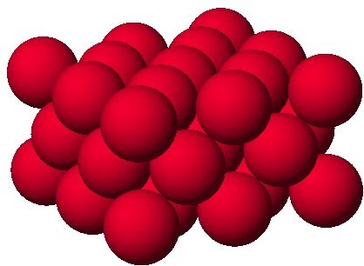
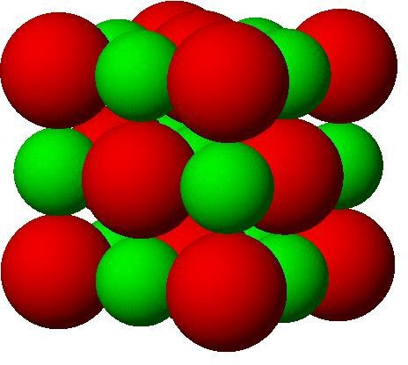
Crystal, Lattice and Motif
Crystal
Cu Crystal
NaCl Crystal
Lattice
FCC
FCC
Motif
1 Cu⁺ ion
1 Na⁺ ion + 1 Cl⁻ ion
90/
90

Slide 90
Crystal, Lattice and Motif
Crystal
Cu Crystal
NaCl Crystal
Lattice
FCC
FCC
Motif
1 Cu⁺ ion
1 Na⁺ ion + 1 Cl⁻ ion
91/
91

Slide 91
NaCl Crystal
Each Na⁺ is surrounded by six Cl⁻ Each Cl⁻ is surrounded by six Na+
Where is the NaCl molecule?
92/
92

Slide 92
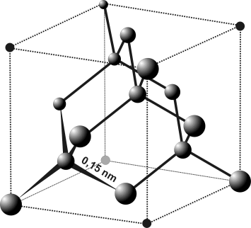
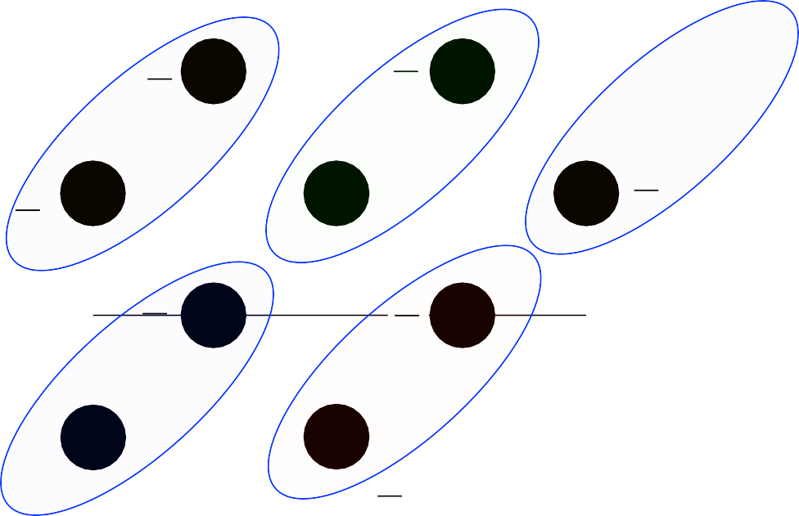
Diamond Cubic Crystal: L^{y} attice₁ & motif?
0,1
2
0,1
M
D
R M
C
R
y
3
1
L
S
P
N
4
4
Q
Q
1
2
D
1
2
T
L
0,1
K
K
S
C
1
4
3
4
N
T
A
x
B
A
P
B _{x}
1
2
0,1
0,1
Projection of the unit cell on the bottom face of the cube
Diamond Cubic Crystal
= FCC lattice + motif: 000; ¼¼¼
93/
93

Slide 93



Geometrical properties of ABAB stacking
A
b = a
A
B
A
γ=120°
A
C _{a}
A
C
C
A
B
B
B
B
A
A
A
C
C
C
c
B
B
B
A
A
A
A
A
C
C
C
B
B
B
A
A
A
A
A and B do not have identical neighbours
Either A or B as lattice points, not both
Unit cell: a rhombus based prism with a=b≠c; α=β=90°, γ=120°
The unit cell contains only one lattice point (simple) but two atoms (motif) ABAB stacking = HCP crystal = Hexagonal P lattice + 2 atom motif 000
2/3 1/3 1⁹/9⁴24/
94

Slide 94
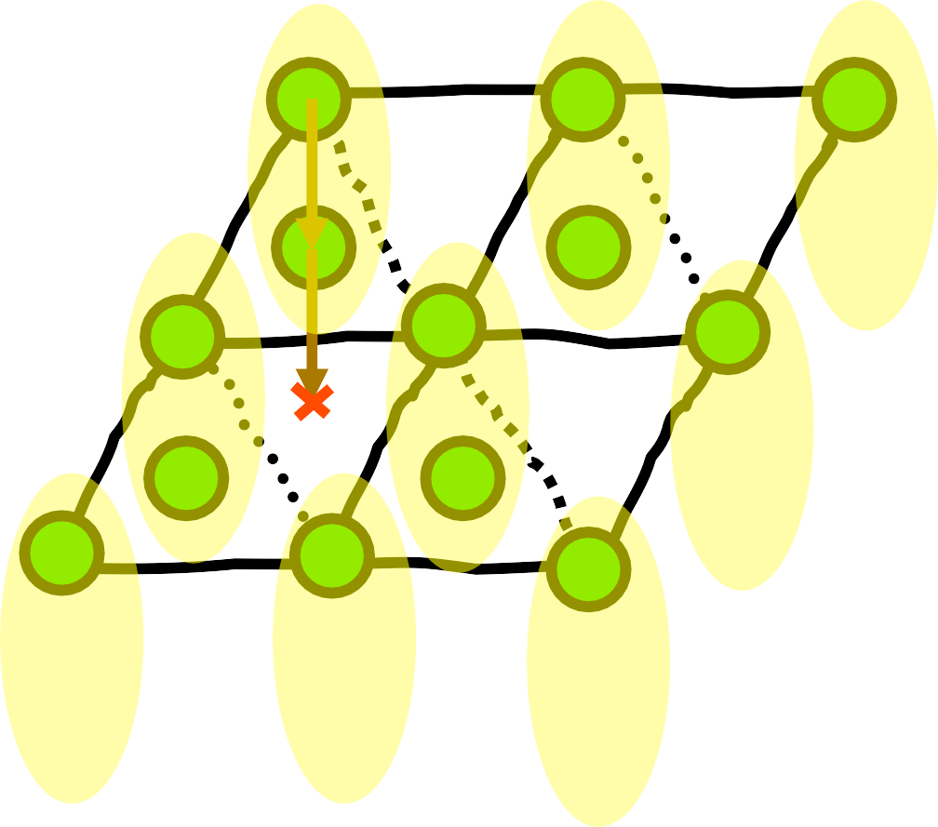
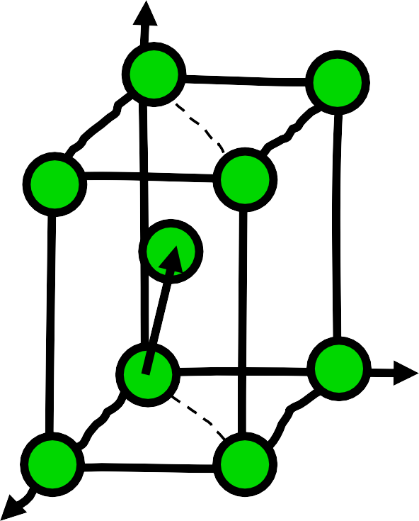
Example:
Hexagonal close-packed (HCP) crystal
z
½
½
y
½
½
Corner and inside atoms do not have the same neighbourhood
x
Lattice: Simple hexagonal
Motif: Two atoms:
000; 2/3 1/3 1/2
hcp lattice
hcp crystal
95/
95

